Slide 1
Department of Applied Mathematics and Computational Sciences
III Sem M.Sc.Software Systems
Transform Techniques
Dr. V. Suresh kumar

Slide 2
Discrete Convolution

Slide 3


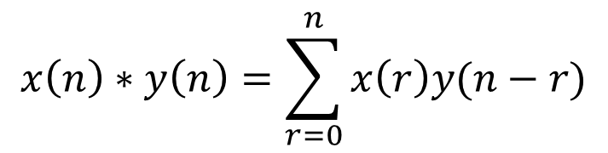
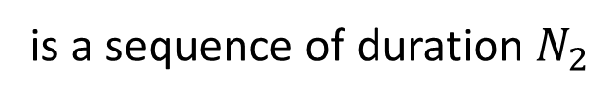
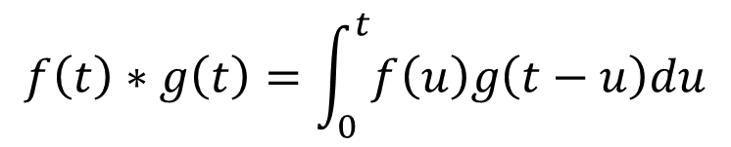






Definition
Recollect that
$$f\left(t\right)∗g\left(t\right)=\int_{0}^{t}{f\left(u\right)g\left(t−u\right)du}$$
For the two well defined functions
$$f\left(t\right)$$
and
$$g\left(t\right)$$
Suppose
$$x\left(n\right)$$
and
$$y\left(n\right)$$
are the two finite sequences then their convolution
$$x\left(n\right)∗y\left(n\right)=\sum_{r=0}^{n}{x\left(r\right)y(n−r)}$$
defined as
take
$$z\left(n\right)=x\left(n\right)∗y\left(n\right)$$
Suppose
$$\left\{x\left(n\right)\right\}$$
is a sequence of duration $N_{1}$ and
$$\left\{y\left(n\right)\right\}$$
is a sequence of duration $N_{2}$
then $\left\{z(n)\right\}$ is a sequence of duration $N_{1}+N_{2}−1$

Slide 4

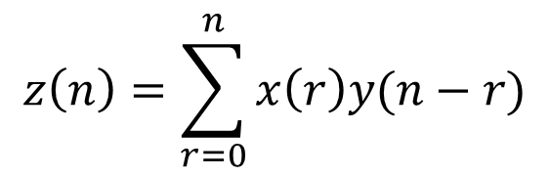




Computation
For
$$\left\{x\left(n\right)\right\}=\{x\left(0\right), x\left(1\right), …, x\left(N_{1}−1\right)\}$$
and
$$\left\{y\left(n\right)\right\}=\{y\left(0\right), y\left(1\right), …, y\left(N_{2}−1\right)\}$$
$$z\left(n\right)=\sum_{r=0}^{n}{x\left(r\right)y(n−r)}$$
By definition
$$z\left(n\right)=x\left(0\right)y\left(n\right)+x\left(1\right)y\left(n−1\right)+x\left(2\right)y\left(n−2\right)+…+x\left(n\right)y(0)$$
$$z\left(0\right)=x\left(0\right)y\left(0\right)$$
$$z\left(1\right)=x\left(0\right)y\left(1\right)+x\left(1\right)y\left(0\right)$$
$$z\left(2\right)=x\left(0\right)y\left(2\right)+x\left(1\right)y\left(1\right)+x\left(2\right)y\left(0\right)$$
$$n=0, 1, 2, …,N_{1}+N_{2}−2$$

Slide 5



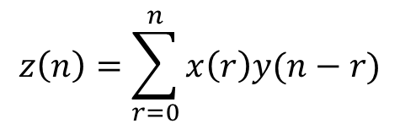

















Example
1. Find the linear convolution of $x\left(n\right)=\{1,2,2,1\}$ and $y\left(n\right)=\{2,1,1,2\}$
Ans:
$$z\left(n\right)=\sum_{r=0}^{n}{x\left(r\right)y(n−r)}$$
$$N_{1}=4$$
$$N_{2}=4$$
$N_{1}+N_{2}−1=7$
$$x\left(0\right)=1$$
$$x\left(1\right)=2$$
$$x\left(2\right)=2$$
$$x\left(3\right)=1$$
$$y\left(0\right)=2$$
$$y\left(1\right)=1$$
$$y\left(2\right)=1$$
$$y\left(3\right)=2$$
$$z\left(n\right)=x\left(0\right)y\left(n\right)+x\left(1\right)y\left(n−1\right)+x\left(2\right)y\left(n−2\right)+…+x\left(n\right)y(0)$$
$$n=0, 1, …, 6$$
$$z\left(0\right)=2$$
$$z\left(2\right)=7$$
$$z\left(4\right)=7$$
$$z\left(6\right)=2$$
$$z\left(1\right)=5$$
$$z\left(5\right)=5$$
$z\left(n\right)=\{2, 5, 7, 8, 7, 5, 2\}$
$$z\left(3\right)=8$$

Slide 6












Example
2. Find the linear convolution of $x\left(n\right)=\{2, 1, 2, 1\}$ and $y\left(n\right)=\{1, 2, 3\}$
Ans:
$$z\left(n\right)=\sum_{r=0}^{n}{x\left(r\right)y(n−r)}$$
$$N_{1}=4$$
$$N_{2}=3$$
$N_{1}+N_{2}−1=6$
$$x\left(0\right)=2$$
$$x\left(1\right)=1$$
$$x\left(2\right)=2$$
$$x\left(3\right)=1$$
$$y\left(0\right)=1$$
$$y\left(1\right)=2$$
$$y\left(2\right)=3$$
$$z\left(n\right)=x\left(0\right)y\left(n\right)+x\left(1\right)y\left(n−1\right)+x\left(2\right)y\left(n−2\right)+…+x\left(n\right)y(0)$$
$$n=0, 1, …, 5$$
$$z\left(0\right)=2$$
$$z\left(2\right)=10$$
$$z\left(4\right)=8$$
$$z\left(1\right)=5$$
$$z\left(5\right)=3$$
$z\left(n\right)=\{2, 5, 10, 8, 8, 3\}$
$$z\left(3\right)=8$$

Slide 7

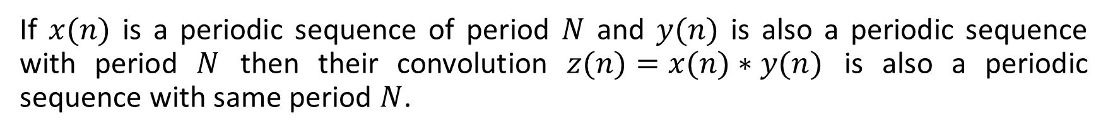
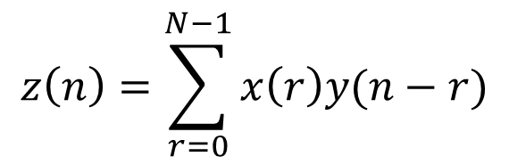
Definition
A sequence $x(n)$ is said to be periodic sequence with period $N$ if $x\left(n+N\right)=x(n)$.
Result
If $x(n)$ is a periodic sequence of period $N$ and $y(n)$ is also a periodic sequence with period $N$ then their convolution $z(n)=x(n)∗y(n)$ is also a periodic sequence with same period $N$.
$$z\left(n\right)=\sum_{r=0}^{N−1}{x\left(r\right)y(n−r)}$$
definition
Periodic convolution
Circular convolution
$$z\left(0\right)=x\left(0\right)y\left(0\right)+x\left(1\right)y\left(0−1\right)+…+x\left(N−1\right)y\left(0−N+1\right)$$
Cyclic convolution
$$z\left(1\right)=x\left(0\right)y\left(1\right)+x\left(1\right)y\left(1−1\right)+…+x\left(N−1\right)y\left(1−N+1\right)$$
$$z\left(2\right)=x\left(0\right)y\left(2\right)+x\left(1\right)y\left(2−1\right)+…+x\left(N−1\right)y\left(2−N+1\right)$$
$$n=0, 1, 2, …,N−1$$

Slide 8

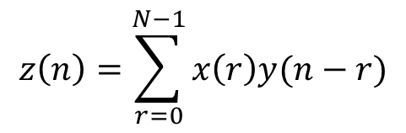






Example
3. Find the circular convolution of $x\left(n\right)=\{1,2,2,1\}$ and $y\left(n\right)=\{2,1,1,2\}$
Ans:
$$z\left(n\right)=\sum_{r=0}^{N−1}{x\left(r\right)y(n−r)}$$
$$N_{1}=4$$
$$N_{2}=4$$
$N=4$
$$x\left(0\right)=1$$
$$x\left(1\right)=2$$
$$x\left(2\right)=2$$
$$x\left(3\right)=1$$
$$y\left(0\right)=2$$
$$y\left(1\right)=1$$
$$y\left(2\right)=1$$
$$y\left(3\right)=2$$
$$z\left(n\right)=x\left(0\right)y\left(n\right)+x\left(1\right)y\left(n−1\right)+x\left(2\right)y\left(n−2\right)+…+x\left(N−1\right)y(n−N+1)$$
$$n=0, 1, 2, 3$$
$$z\left(0\right)=x\left(0\right)y\left(0\right)+x\left(1\right)y\left(0−1\right)+x\left(2\right)y\left(0−2\right)+x\left(3\right)y\left(0−3\right)$$
$$=x\left(0\right)y\left(0\right)+x\left(1\right)y\left(−1\right)+x\left(2\right)y\left(−2\right)+x\left(3\right)y\left(−3\right)$$
$$z\left(0\right)=9$$
$$z\left(2\right)=9$$
$$=x\left(0\right)y\left(0\right)+x\left(1\right)y\left(3\right)+x\left(2\right)y\left(2\right)+x\left(3\right)y\left(1\right)$$
$$z\left(1\right)=10$$
$$z\left(3\right)=8$$
$$=\left(1\right)\left(2\right)+\left(2\right)\left(2\right)+\left(2\right)\left(1\right)+\left(1\right)\left(1\right)$$
$z\left(n\right)=\{9, 10, 9, 8\}$

Slide 9
Methods for finding circular convolution
Matrix Multiplication Method (MMM)
Circular Representation Method (CRM)

Slide 10
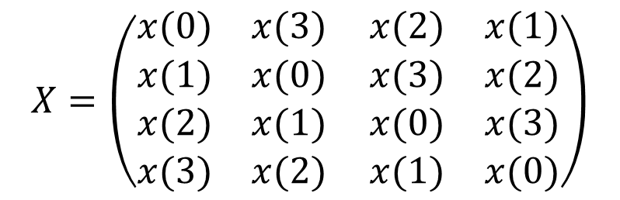
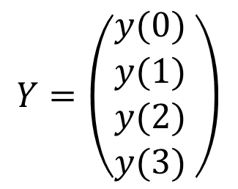
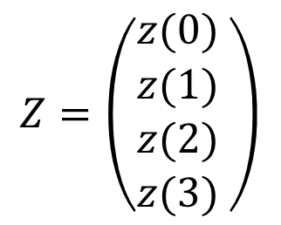
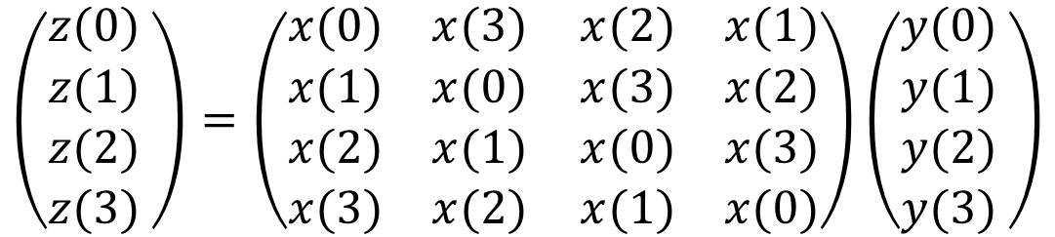
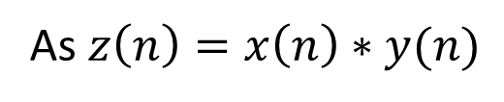
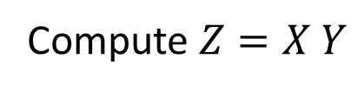
Matrix Multiplication Method (MMM)
Consider the two periodic sequences $\{x\left(n\right)\}=\left\{x\left(0\right), x\left(1\right), x\left(2\right), x(3)\right\}$ and $\{y\left(n\right)\}=\left\{y\left(0\right), y\left(1\right), y\left(2\right), y(3)\right\}$ each of period $N=4$.
Their convolution $\{z\left(n\right)\}=\left\{z\left(0\right), z\left(1\right), z\left(2\right), z(3)\right\}$
$$X=\left(\begin{matrix}\begin{matrix}\begin{matrix}x(0) \\ x(1)\end{matrix} \\ \begin{matrix}x(2) \\ x(3)\end{matrix}\end{matrix} & \begin{matrix}\begin{matrix}x(3) \\ x(0)\end{matrix} \\ \begin{matrix}x(1) \\ x(2)\end{matrix}\end{matrix}\end{matrix} \begin{matrix}\begin{matrix}\begin{matrix}x(2) \\ x(3)\end{matrix} \\ \begin{matrix}x(0) \\ x(1)\end{matrix}\end{matrix} & \begin{matrix}\begin{matrix}x(1) \\ x(2)\end{matrix} \\ \begin{matrix}x(3) \\ x(0)\end{matrix}\end{matrix}\end{matrix}\right)$$
As $z\left(n\right)=x\left(n\right)∗y(n)$
Take
$$Z=\left(\begin{matrix}\begin{matrix}z(0) \\ z(1)\end{matrix} \\ \begin{matrix}z(2) \\ z(3)\end{matrix}\end{matrix} \right)$$
$$Y=\left(\begin{matrix}\begin{matrix}y(0) \\ y(1)\end{matrix} \\ \begin{matrix}y(2) \\ y(3)\end{matrix}\end{matrix} \right)$$
Compute $Z=X Y$
and
$$\left(\begin{matrix}\begin{matrix}z(0) \\ z(1)\end{matrix} \\ \begin{matrix}z(2) \\ z(3)\end{matrix}\end{matrix} \right)=\left(\begin{matrix}\begin{matrix}\begin{matrix}x(0) \\ x(1)\end{matrix} \\ \begin{matrix}x(2) \\ x(3)\end{matrix}\end{matrix} & \begin{matrix}\begin{matrix}x(3) \\ x(0)\end{matrix} \\ \begin{matrix}x(1) \\ x(2)\end{matrix}\end{matrix}\end{matrix} \begin{matrix}\begin{matrix}\begin{matrix}x(2) \\ x(3)\end{matrix} \\ \begin{matrix}x(0) \\ x(1)\end{matrix}\end{matrix} & \begin{matrix}\begin{matrix}x(1) \\ x(2)\end{matrix} \\ \begin{matrix}x(3) \\ x(0)\end{matrix}\end{matrix}\end{matrix}\right)\left(\begin{matrix}\begin{matrix}y(0) \\ y(1)\end{matrix} \\ \begin{matrix}y(2) \\ y(3)\end{matrix}\end{matrix} \right)$$

Slide 11
















Circular Representation Method (CRM)
Consider the two periodic sequences $\{x\left(n\right)\}=\left\{x\left(0\right), x\left(1\right), x\left(2\right), x(3)\right\}$ and $\{y\left(n\right)\}=\left\{y\left(0\right), y\left(1\right), y\left(2\right), y(3)\right\}$ each of period $N=4$.
Their convolution $\{z\left(n\right)\}=\left\{z\left(0\right), z\left(1\right), z\left(2\right), z(3)\right\}$
$$x\left(1\right)$$
$$x\left(1\right)$$
$$y(3)$$
$$y(0)$$
$$x\left(2\right)$$
$$x\left(2\right)$$
$$y\left(2\right)$$
$$y\left(0\right)$$
$$x\left(0\right)$$
$$y\left(3\right)$$
$$y\left(1\right)$$
$$x\left(0\right)$$
$$y\left(1\right)$$
$$y\left(2\right)$$
$$x(3)$$
$$x(3)$$
$$z(0)=x\left(0\right)y\left(0\right)+x\left(1\right)y\left(3\right)+x\left(2\right)y\left(2\right)+x\left(3\right)y\left(1\right)$$
$$z(1)=x\left(0\right)y\left(1\right)+x\left(1\right)y\left(0\right)+x\left(2\right)y\left(3\right)+x\left(3\right)y\left(2\right)$$

Slide 12
















CRM contd…
$$x\left(1\right)$$
$$x\left(1\right)$$
$$y(1)$$
$$y(2)$$
$$x\left(2\right)$$
$$x\left(2\right)$$
$$y\left(2\right)$$
$$y\left(1\right)$$
$$y\left(3\right)$$
$$x\left(0\right)$$
$$y\left(0\right)$$
$$x\left(0\right)$$
$$y\left(3\right)$$
$$y\left(0\right)$$
$$x(3)$$
$$x(3)$$
$$z(2)=x\left(0\right)y\left(2\right)+x\left(1\right)y\left(1\right)+x\left(2\right)y\left(0\right)+x\left(3\right)y\left(3\right)$$
$$z(3)=x\left(0\right)y\left(3\right)+x\left(1\right)y\left(2\right)+x\left(2\right)y\left(1\right)+x\left(3\right)y\left(0\right)$$

Slide 13

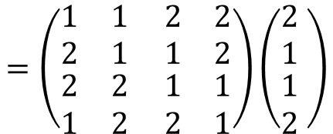
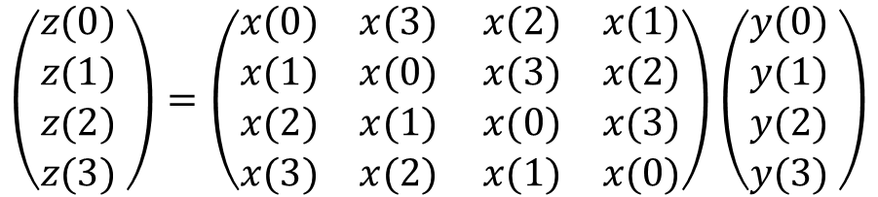





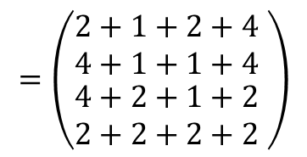



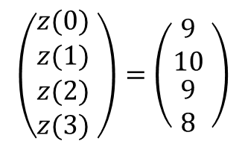
Example
4. Find the circular convolution of $x\left(n\right)=\{1,2,2,1\}$ and $y\left(n\right)=\left\{2,1,1,2\right\}$ using MMM and CRM
$N=4$
$$x\left(0\right)=1$$
$$x\left(1\right)=2$$
$$x\left(2\right)=2$$
$$x\left(3\right)=1$$
(i) MMM
$$y\left(0\right)=2$$
$$y\left(1\right)=1$$
$$y\left(2\right)=1$$
$$y\left(3\right)=2$$
$$\left(\begin{matrix}\begin{matrix}z(0) \\ z(1)\end{matrix} \\ \begin{matrix}z(2) \\ z(3)\end{matrix}\end{matrix} \right)=\left(\begin{matrix}\begin{matrix}\begin{matrix}x(0) \\ x(1)\end{matrix} \\ \begin{matrix}x(2) \\ x(3)\end{matrix}\end{matrix} & \begin{matrix}\begin{matrix}x(3) \\ x(0)\end{matrix} \\ \begin{matrix}x(1) \\ x(2)\end{matrix}\end{matrix}\end{matrix} \begin{matrix}\begin{matrix}\begin{matrix}x(2) \\ x(3)\end{matrix} \\ \begin{matrix}x(0) \\ x(1)\end{matrix}\end{matrix} & \begin{matrix}\begin{matrix}x(1) \\ x(2)\end{matrix} \\ \begin{matrix}x(3) \\ x(0)\end{matrix}\end{matrix}\end{matrix}\right)\left(\begin{matrix}\begin{matrix}y(0) \\ y(1)\end{matrix} \\ \begin{matrix}y(2) \\ y(3)\end{matrix}\end{matrix} \right)$$
$$=\left(\begin{matrix}\begin{matrix}\begin{matrix}1 \\ 2\end{matrix} \\ \begin{matrix}2 \\ 1\end{matrix}\end{matrix} & \begin{matrix}\begin{matrix}1 \\ 1\end{matrix} \\ \begin{matrix}2 \\ 2\end{matrix}\end{matrix}\end{matrix} \begin{matrix}\begin{matrix}\begin{matrix}2 \\ 1\end{matrix} \\ \begin{matrix}1 \\ 2\end{matrix}\end{matrix} & \begin{matrix}\begin{matrix}2 \\ 2\end{matrix} \\ \begin{matrix}1 \\ 1\end{matrix}\end{matrix}\end{matrix}\right)\left(\begin{matrix}\begin{matrix}2 \\ 1\end{matrix} \\ \begin{matrix}1 \\ 2\end{matrix}\end{matrix} \right)$$
$$\left(\begin{matrix}\begin{matrix}z(0) \\ z(1)\end{matrix} \\ \begin{matrix}z(2) \\ z(3)\end{matrix}\end{matrix} \right)=\left(\begin{matrix}\begin{matrix}9 \\ 10\end{matrix} \\ \begin{matrix}9 \\ 8\end{matrix}\end{matrix} \right)$$
$$=\left(\begin{matrix}\begin{matrix}2+1+2+4 \\ 4+1+1+4\end{matrix} \\ \begin{matrix}4+2+1+2 \\ 2+2+2+2\end{matrix}\end{matrix} \right)$$

Slide 14


















Example contd…
(ii) CRM
$$2$$
$$2$$
$$2$$
$$2$$
$$2$$
$$2$$
$$2$$
$$2$$
$$1$$
$$1$$
$$1$$
$$1$$
$$1$$
$$1$$
$$1$$
$$1$$
$$z\left(0\right)=\left(1\right)\left(2\right)+\left(2\right)\left(2\right)+\left(2\right)\left(1\right)+(1)(1)$$
$$z\left(1\right)=\left(1\right)\left(1\right)+\left(2\right)\left(2\right)+\left(2\right)\left(2\right)+(1)(1)$$
$$z\left(0\right)=9$$
$$z\left(1\right)=10$$

Slide 15


















CRM contd…
$$2$$
$$2$$
$$1$$
$$1$$
$$2$$
$$2$$
$$1$$
$$1$$
$$2$$
$$1$$
$$2$$
$$1$$
$$2$$
$$2$$
$$1$$
$$1$$
$$z\left(2\right)=\left(1\right)\left(1\right)+\left(2\right)\left(1\right)+\left(2\right)\left(2\right)+(1)(2)$$
$$z\left(3\right)=\left(1\right)\left(2\right)+\left(2\right)\left(1\right)+\left(2\right)\left(1\right)+(1)(2)$$
$$z\left(0\right)=9$$
$$z\left(1\right)=8$$

Slide 16


